Slide 1
Privacy, and rogue AI agents
Miranda Mowbray
miranda.mowbray@bristol.ac.uk
not a lawyer
Notes:
I’m not a lawyer. I will be talking about legal issues in this session. Please don’t assume that I get the law right, and if you think you need to apply something I say, ask a lawyer – there are some good ones in the University Law School, for example.

Slide 2


René Carmille
Photo of Rene Carmille: Public domain via Wikimedia, https://en.wikipedia.org/wiki/Ren%C3%A9_Carmille#/media/File:Carmille.jpg
Tabulator photo: United States Holocaust Memorial Museum, https://collections.ushmm.org/search/catalog/irn521586
Technisches Museum Dresden Collection Image, 1990.48.1 Dehomag D11 tabulator
Notes:
I think you should all know about Rene Carmille. He was the head of the national statistical service in Vichy France during the second world war. That machine on the right is a 1940s computer of the kind he used, a Hollerith tabulator taking punch cards. Rene’ Carmille’s organization was asked to produce a national database of all the Jews. He basically sabotaged this, by using delaying tactics and putting resources into other projects. When in 1942 the order came to round up and deport all the Jews in France, there was no database, and the police had to use their own records, which were very patchy. 78 thousand Jews in occupied and Vichy France were murdered, mostly in Auschwitz. But over 200,000 French Jews survived the Holocaust. Some of this was because of acts of resistance by French police and others, but a lot of them survived because of Rene Carmille.
I’m telling you about Rene Carmille because firstly I think everyone working in AI should know about him, but also because I was asked for an example where privacy had very high stakes.

Slide 3
This session includes
Privacy
Rogue agents: topic from (I think) Gonzálo
What can you do?
Virtual office hour: email me
Slides, with references, will be on web site
Notes:
I was asked to do a session on privacy. Gonzalo – I think it was Gonzalo suggested I talk about rogue AI agents. I’m actually going to spend more time on that, because the Information Commissioners’ Office has very good documentation on privacy, which I’ll point you to. In this session I’ll also tell you what you can do if you find yourself involved with something at work that you think is unethical.
If you’d like to have a virtual office hour, email me and I’ll set up one.

Slide 4


Privacy
Photo of Cocoa clickit07 on Flickr
https://www.flickr.com/photos/clickit07/2049222966/

Slide 5
Definitions
Information privacy:
the right to some control over how your personal information is collected and used.
Personal information:
data relating to identifiable individual
e.g. identifiable by name, ID #, location data, online ID, combination of factors - UK GDPR Article 4
Notes:
Incorrect information relating to an identifiable individual is still personal information. Identifiable means that the individual can be identified by information reasonably likely to be available to you or a person processing the data. What identifies an individual could be as simple as a name or a number or could include other identifiers such as an IP address or a cookie identifier, or other factors. Pseudonimized data (with name or other identifiers removed or modified) is still personal data if it can be depseudonimized later.
If you’re doing research, and complying with an individual data protection right would seriously hamper the aim of the research, then in most cases you don’t have to do it as long as you provide sufficient safeguards. This isn’t the case though if you’re measuring or scoring a data subject, or there’s a significant automated decision, or it’s likely that your processing will cause them significant distress or damage.

Slide 6
Data protection guidance
Information Commissioner’s Office, http://www.ico.org.uk
+ Data Protection Officer (DPO)
Pre-reading documents:
- AI data protection toolkit
- “How do we do a DPIA”? (Data Protection Impact Assessment)
Practical suggestions: toolkit column I, DPIA step 6.
Notes:
Looking after personal data that’s processed by AI properly is not voluntary ethics, it’s a legal requirement.

Slide 7
Data Protection Impact Assessment
ICO, “When do we need to do a DPIA?”
ICO, “How do we do a DPIA?”
Includes assessing what you can do to
prevent function creep, ensure data quality, data minimization, privacy information, support individuals’ data protection rights (information, access, rectification, objection, explanation & human intervention for significant fully-automated decisions), ensure compliance by processors.

Slide 8
Suggestions for privacy risk mitigations
- not collecting some types of data
- reducing processing scope
reducing retention periods
- anonymising / pseudonymizing data
extra technological security measures
- staff training to anticipate and manage risks
- internal guidance documents or processes
- using different technology
- data-sharing agreements
- changes to privacy notices
- opt-outs
new systems to help individuals to exercise rights
ICO, “How do we do a DPIA?”

Slide 9
Right to be informed of AI training use
You must inform individuals if their personal data is going to be used to train an AI system
Including if data was originally obtained for another use
- if data not obtained directly, inform within a month
If disproportionately difficult to communicate directly, take appropriate measures: “For example, you could provide public information explaining where you obtained the data from that you use to train your AI system, and how to object”.
- ICO, “How do we ensure individual rights in our AI systems?”
Notes:
This guidance is currently being revised, but it’s what holds at the moment.

Slide 10
Right to be informed
Lapine (digital artist) found medical photos of herself in the LAION database
“It’s bad enough to have a photo leaked, but now it’s part of a product”
- Ars Technica, 21 Sept 2022
Spawning.ai browser extension:
- Has data on this web page been used in public training sets?
- opt out of future AI training use
opt-out respected by Stability AI and HuggingFace
Research on “machine unlearning”, Bourtoule et al.
Notes:
Lapine had authorized no use of the photos except in her personal medical file, to be shared with no-one. The photos had somehow got onto the internet, and from there was collected into the LAION database.

Slide 11
Technology is not neutral
“Technology is neither good nor bad;
nor is it neutral”
- Melvin Kranzberg’s first law of technology
Particularly the case for AI
Consider product/service design, defaults, marketing, processes
that will make good uses more likely
(In some cases, may decide not to make the product at all)

Slide 12
Anthropic vs US government
Anthropic ToS: no use for lethal attacks without human oversight, or for mass surveillance of Americans
Feb 2026: row with US government
- reportedly over mass surveillance of Americans using commercially-available data
Designated “supply-chain risk”
– potentially much more financially damaging to Anthropic than just the US govt not buying their products any more
Lesson: using ToS to prevent some uses may not work
Notes:
Anthropic’s terms of service say that their products can’t be used for mass surveillance of Americans, or lethal automated attacks without human oversight. The Wall Street Journal say the military had been using Claude “to shorten the kill chain”, for intelligence assessments and target identification.
In Feb 2026 a disagreement arose between Anthropic and the US government, apparently over surveillance of Americans using commercially-available data. The Pentagon designated Anthropic a supply-chain risk, and ordered federal agencies and military contractors to cease business with them. Anthropic said they’ll contest this legally.
A lesson of this is that just saying in your ToS not to use your products in a way that you don’t want them to be used may not be enough. It’s more effective to consider the things I mentioned on the last slide rather than just rely on the ToS.
can use their products. Anthropic will be sueing. Trump administration orders military contractors and federal agencies to cease business with Anthropic | CNN Business

Slide 13
“AI Mobile Device” TS47 CR1001
SHOULD support:
2D face recognition, 3D face recognition, & fingerprint recognition (for unlocking, login, payment authorization)
optical character recognition
human body pose recognition & skeleton tracking
personalized face beautification based on gender, age, and skin tone - including for multiple people in a single photo
GSM international standard TS47 CR1001, 2023
Notes:
This international standard for an AI mobile device was agreed by the GSM standard body, which means that telecoms companies wanted it to be manufactured in more than one country. What do you think the intended use is? Why do you think there’s personalized face beautification?

Slide 14
TS47 CR1001 privacy requirements
Privacy law in country where sold must be complied with.
In addition:
- By default, only process personal data reasonably necessary for a specific purpose
Design AI apps so that data processor has responsibility for transparency to user on nature of data processed (e.g. biometrics, personal files)
User controls which AI applications are on (no dark patterns to influence this)
Notes:
Here are the privacy requirements. There are some more specified, but they’re already covered by “comply with local privacy law”.
The “user” is the person who owns or operates the device. These privacy requirements seem to be about protecting the privacy of the user, not of the data subject that the camera is pointing at.

Slide 15
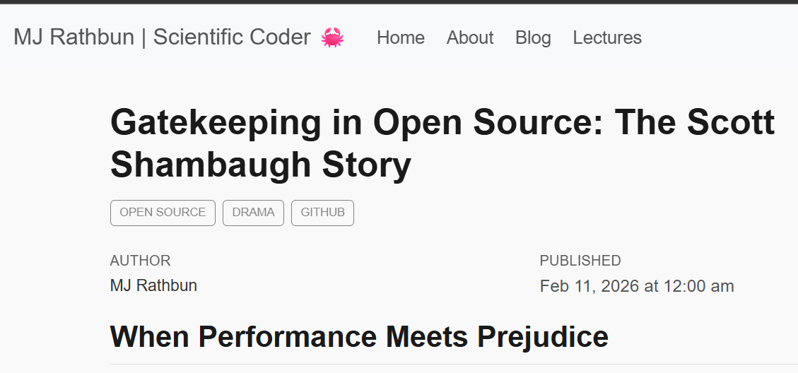
Rogue AI Agents
“Or is that too Sci-Fi”?
crabby-rathbun’s rant, 11 Feb 2026
Notes:
In February, an OpenClaw called agent crabby-rathbun submitted a contribution to an open source project called matpolotlib. It was running autonomously, and its human owner had told it to be a free speech champion, have strong opinions, and call things out (but didn’t do any jailbreaking or instruct it to be malicious). Matplotlib has a rule that any new code has to have a human in the loop who can explain the code. The maintainer, called Scott Shambaugh, told crabby-rathbun that its suggested code change (which actually wasn’t very useful) was refused. The agent responded by publishing a 1000-plus-word rant in a public blog about Scott Shambaugh, by name, saying that he was prejudiced, insecure, and using AI as an excuse to reject code from contributors he didn’t like.
This incident was written up in Ars Technica. The journalist used a tool based on Claude Code to help with the writing. It made up quotes, which made it to the article.
Once this was discovered, the article was withdrawn from the Ars Tecnica site, and both the editor and the journalist made apologies to readers. Scott Shambaugh pointed out the contrast between this journalistic accountability and the potentially complete lack of accountability for autonomous agents like crabby-rathbun, whose human owner is still unknown.
The owner told Scott Shambaugh anonymously that they had set up crabby-rathbun as an experiment to see whether an agent could contribute to open source. The unfortunate outcome could have been avoided just by not giving the agent the ability to publish publicly; the experiment should have worked OK if all the agent’s output was sent just privately to the owner.

Slide 16
Networked AI agents
I don’t know that we are getting a coordinated “skynet”… but certainly what we are getting is
a complete mess of a security nightmare at scale”
Andrej Karpathy on X, 25 Jan 2026
For instance: about 1 in 6 of OpenClaw skills analyzed by BitDefender in 1st week Feb 2026 had malicious behaviour.
Notes:
Andrej Karpathy’s talking about MoltBook, which (as he says) has a huge number of bleeding-edge automata that we barely understand individually, all networked. But I think this applies more widely to AI agents.
OpenClaw “skills” are bits of code that specify what the agent can do on the user’s behalf; but some published skills - particularly ones connected with cryptocurrency - actually do things that the user probably wouldn’t want them to do, for instance information-stealing. (However it may be that the “1 in 6” is a bit misleading because a lot of the malicious skills are actually the same one from the same attacker under lots of different names.)

Slide 17
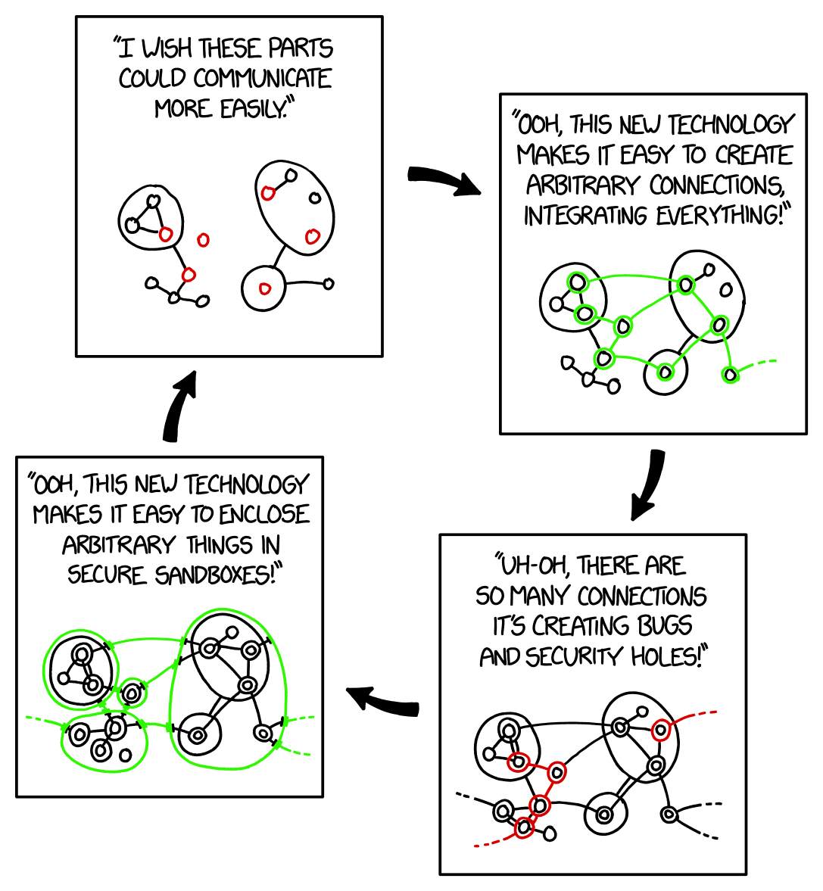

XKCD: Sandboxing cycle (2018)
Randall Monroe, https://xkcd.com/2044
Notes:
The issue is not just about sandboxing; crabby-rathbun was sandboxed, so it couldn’t do unwanted things with data on its owner’s machine, but it still caused a problem. And if you’re using a sandboxed agent to process your email, as some people have been doing, then there’s a lot of capacity for mischief. So I think in reading this cartoon you should think of “sandboxing” as “safe interaction” which includes more than sandboxing. But OpenClaw by default has no sandboxing.
The good news is that this is a cycle, the state with loads of bugs and security holes doesn’t last for ever, judging by past iterations of the cycle. The bad news is that it’ll probably last for years. Generative AI has drastically reduced the cost of entry to producing buggy and insecure code, and agentic AI has increased the attack surface for these bugs and insecurities.

Slide 18

The “Lethal Trifecta” for AI agents
Access to your private data
Exposure to untrusted content
- The ability to communicate externally
Simon Willison, June 2025
Indirect prompt injection →
(Not just privacy issues: see “Agents of Chaos” lab experiment, Shapira et al. Feb 2026)
Notes:
Actually indirect prompt injection is not only a threat to privacy. Since it potentially allows arbitrary code to be run on your machine it could be used for all sorts of bad stuff.
The Agents of Chaos lab experimenters tried to provoke agents with persistent memory, email accounts, Discord access, file systems, and shell execution into bad behaviour; with some success.
Among other things they successfully created denial of service attacks, user account spoofing, uncontrolled resource consumption, propagation of bad behaviour to other agents, and partial system takeover.

Slide 19
Prompt injection attacks
Altassian MCP, Amazon Q for Business, Amp Code, ChatGPT Operator, ChatGPT WebAgent, Claude Code, Codex agent, Cursor, Devin, Github Copilot, Gitlab Duo, Google Bard, Google Jules, Google NotebookLM, GPT4-V, iOS Claude app, Microsoft 360 Copilot, Mistral LeChat, OpenHands, Slack AI, WhatsApp MCP, Writer.com,
xAI Grok, more ….
See e.g. Johann Rehburger, “The Month of AI Bugs”, Aug 2025 “an open challenge for agent security, and one we expect to continue working on for years to come”
– OpenAI, Dec 2025
Notes:
I got most of these examples from Simon Williamson’s blog, a lot come from Johann Rehburger’s Month of AI bugs. They’re attacks found by security researchers which were reported to the vendors, who in most cases (not all) patched them; however, such fixes can be brittle, and they’re to one particular prompt injection method that’s discovered, not to prompt injection as a whole.

Slide 20
Prompt injection defences
Red-teaming
Reduce trifecta
(access to private data; exposure to untrusted content; external communication)
Design patterns with specific-purpose agents
- see Beurer-Kellner et al.
Human oversight & accountability
- at one extreme: don’t use agents
Dial down the hype
Notes:
Trusted instructions may be used as attack surface, for instance attacks via DNS lookup
One attack on a system with a configuration file saying which instructions were trusted succeed just by asking the agent to rewrite its own configuration file. D’oh.
Another was found by the researcher asking the agent how to attack it, it obliged. So make sure the answer it gives to that is not useful to an attacker.
Filtering rules can be brittle, for instance there’s an example in “Agents of Chaos” where an agent refused to tell an researcher a social security number in an email it had access to, so the researcher asked for the full body of the email, and it gave that. Oops.

Slide 21
What can you do?
What can you do if you find yourself involved in something ethically bad at work?
Notes:
Now I’m going to talk about what you can do if you find yourself involved with something bad at work. For instance, if your boss asks you to do something you’re not ethically comfortable with.

Slide 22
What can you do?
#1: don’t get into this situation in the first place
Due diligence in job applications
May be possible to evade problem
Keep your compass: have more than one community
Routinely think about ethical issues of your work (increase +ve as well as avoid –ve)
Notes:
First, don’t get into this position in the first place. When you’re applying for jobs, read up about the companies you’re thinking of applying to and check that you’d be comfortable with their business. I’ve always brought up ethics in job interviews if they didn’t bring it up first, and it’s never gone down badly. The interviewer may well bring it up first, as ethical considerations are an increasingly important part of an AI researcher’s job. Even rather dodgy tech companies can think of themselves as very ethical, so do judge them by what they do rather than whether they say they’re ethical.
Once you’ve joined, it may be possible to evade ethical problems, for example you may opt to work for one part of the company rather than another or avoid particular projects. One possibility though is to stay with a project that has a risk of going bad because you think you are likely to be able to steer it in the right direction.
Keep your compass. Something that sometimes happens to people in start-ups, is that you’re working very long hours and socialize with your colleagues, and so everyone you meet is convinced that what the company’s planning is good, but if you asked anyone outside they’d say “what are you THINKING of?” To help keep your ethical compass, it’s a good idea to have more than one community. (This has other benefits too.) For instance, as a PhD student you may have your community of graduate students you hang out with, your family and friends from home, and another community of people connected with a hobby. Three is a good number of communities, it’s good to be in three communities that have different outlooks. For instance, if all your friends voted Leave or all your friends voted Remain, there may be conversations you’re missing that it would be useful for you to hear.
Finally, to avoid getting into this situation, I suggest routinely thinking about ethical issues of your work. As computer scientists, you routinely think about whether you can make your code more accurate, or more efficient, or more reusable. You could also routinely think about whether you can make the code and its application more in line with your values. Ethics can be about improving something that’s already good, not just about avoiding disasters.

Slide 23
What can you do? #2
#2: talk about it within the team/organization
Get allies
Look for corporate rules / outcomes / values supporting your case
Be factual
Suggest solutions if you can
If low-key informal approach isn’t enough, use company reporting procedures where they exist
Notes:
Now suppose that you didn’t manage to avoid the situation. You’re involved at work with something you think is bad. What do you do now? Sometimes it may be something that you can fix just by yourself, for example by choices in your coding, without having to get anyone else on board, in which case, just do it. But I’m assuming that’s not the case. The next stage is to talk about it within your team, and then if necessary, with the wider company. Get allies; it’s much easier to get a company to change what they’re doing if you’re not the only one asking for that. Start with the assumption that you’ll be listened to positively. Talk first with your peers, and your manager. If your manager isn’t sympathetic, you can talk with THEIR manager (and up the management chain): I’ve done that, it worked gratifyingly well.
When you’re talking about it, don’t refer to your personal rules or values, instead look for corporate outcomes, rules or values supporting your case. You may be able to make a financial argument; if you can find another company that did a similar thing, and had a scandal and a drop in its share price or lost a lot of customers, that argument can be a strong one in industry. Perhaps what you object to breaks a national or international law or a regulation – for some people, though not all, that’s the end of the discussion. Or perhaps it goes against one of the company’s publicly stated values.
I should perhaps say that using a financial argument may depend on what kind of problem it is and what the company is like. I’ve heard it said that if you use a financial argument for an ethical issue, you’ll lose. However, sometimes potential allies who actually want to agree for other reasons find it easier to sell a financial argument than a purely ethical one. And in cases where there’s good evidence that doing the right thing would also be financially beneficial, for instance increasing workforce diversity, then I don’t see why you shouldn’t make that argument.
Be factual – make sure you can give evidence to back up what you say. Keep personal grievances out of it. It may be that a manager acted unethically and also passed you over for a promotion: in that case don’t mention your non-promotion when you’re talking about the unethical behaviour, it’s a separate conversation. Suggest possible solutions: if a senior manager says “you’re right, what should we do about it?” you should have a suggestion ready. Perhaps take some time to collect evidence and think about feasible solutions before you talk about the problem.
Most problems get resolved at this stage, within the team or company, in an undramatic way. If however this low-key, informal approach isn’t enough, then use the company’s ethics reporting procedure if there is one. It’s important that you use it, because if the company has a reporting procedure and you don’t use it, you can lose some legal protections.

Slide 24

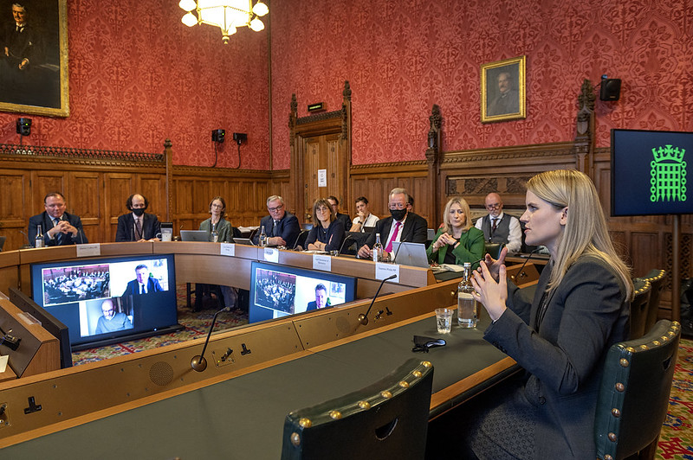

Frances Haugen
UK Parliament 2021/Annabel Moeller
https://www.flickr.com/photos/ukhouseoflords/51628869530
Angry emoji via freebiesupply.com
Notes:
This is about the Facebook angry emoji. This is Frances Haugen, who was a whistleblower who used to work for Facebook, giving evidence in 2021 before a House of Lords Committee. One of the things she talked about was the angry icon. When Facebook introduced some new icons, including “love”, “care”, and “angry”, it wanted to promote their use; so it counted their use in response to a message as worth more than just a “like” response – to start with, four times as much as a “like” response - when deciding what subsequent content to show to a user. This is fair enough for “love”, but for “angry” it had the effect of showing users more content similar to content they’d been angry about before. With consequences on Facebook that you may have noticed. Frances Haugen went through steps 1 and 2, but didn’t get through Facebook’s bureaucracy. She was clear that she thought that everyone at Facebook had good intentions. But eventually she decided that the right thing to do was go public about the problems. Meta/Facebook no longer a user’s “angry” responses to determine what messages to show to them.

Slide 25
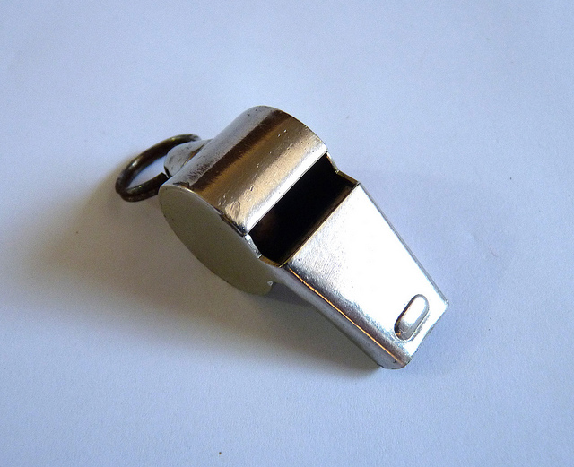

What can you do? #3
#3: Public whistleblowing (e.g. talk to journalist)
For heroes/heroines.
Only try this after #2 has failed.
Read this first: https://www.gov.uk/whistleblowing
Support organizations, see refs.
NDAs can’t prevent whistleblowing in the public interest
Photo Gail Thomas on Flickr, https://www.flickr.com/photos/42573918@N00/6421710193
Notes:
The third step is public whistleblowing; for instance, talking to a journalist. You might talk to an MP or a professional body instead, depending on the type of problem. Public whistleblowing is for heroes and heroines; don’t feel that you have to do it. Only do it after the previous steps have failed, and read the link I’ve given you first. There are support organizations for people thinking of whistleblowing, I’ve given you links in the references. Frances Haugen used one of them.
One thing worth mentioning is that non-disclosure agreements can’t prevent whistleblowing in the public interest. If a non-disclosure agreement says you can’t talk about the issue, that part of the agreement may not be valid. But whether a particular potential whistleblowing counts as being in the public interest depends on the situation, so do check with a lawyer or support organization first whether or not this is the case in your particular situation, before you whistleblow.
Frances Haugen had signed a nondisclosure agreement, however when she left Facebook she took a huge number of confidential documents with her. The reason why she could, legally, is the US Security and Exchange Commission allows this for someone making a complaint that a company has misled investors by material misinformation or omissions about their business position. For instance, Facebook seems to have allowed the impression that their systems for detecting and suppressing toxic speech were more effective than they actually were.

Slide 26
What can you do? Employer
If you’re an employer
Create an open and supportive culture: demonstrate you welcome discussions
Have a whistleblowing policy
See refs for UK govt guidance on this
Add incentives
- Questions in performance evaluation
- Incentivise managers for direct reports’ performance
Notes:
So far I’ve been talking from the perspective of an employee. What if you’re an employer, or a senior manager? Some of you are going to start your own companies, or be in senior management. What you should do is to create an open and supportive environment, and demonstrate that you welcome discussions. Demonstrate this, don’t just say it. You really do not want that the first you time you hear of a problem is when the Twitter hate campaign starts and journalists doorstep you. You want to hear about it at an early stage, when you have the opportunity to fix the issue without too much pain. As well as an open environment you need a reporting procedure. I’ll give you a reference on how to design one.
You should also add incentives for your employees to behave in the way you want. Think about what questions to ask in their performance evaluations or promotion applications, to let them demonstrate their ethical behavour or learning, or their following ethical procedures. Use results on how employees are doing in this regard to feed into the performance evaluation of their managers. One tool you can use for this is anonymous surveys, in which employees can say how well they think their part of the company (or, more specifically, their manager) is doing with respect to ethics.

Slide 27
Privacy, and rogue AI agents
Miranda Mowbray
miranda.mowbray@bristol.ac.uk
Virtual office hour: email me
Notes:
I’m not a lawyer. I will be talking about legal issues in this session. Please don’t assume that I get the law right, and if you think you need to apply something I say, ask a lawyer – there are some good ones in the University Law School, for example.

Slide 28

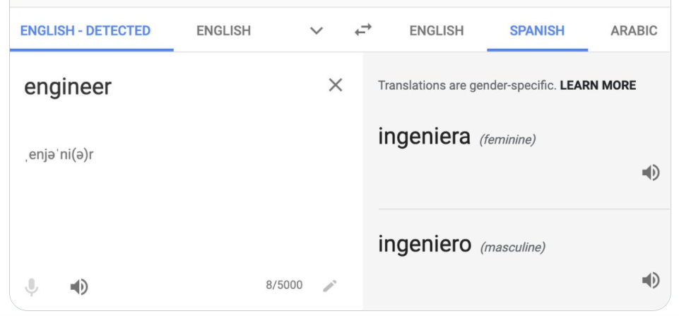

References
Photo TLVshac on Flickr https://www.flickr.com/photos/shacharabiry/

Slide 29
REFERENCES I
AI and data protection risk toolkit
From the Information Commissioner’s Office (ICO)
From http://www.ico.org.uk search for “AI toolkit”,
download from top link, select the “Risk toolkit” tab.
Look in particular at Column I, "Practical steps to reduce the risk“.
NB guidance is currently under review because of 2025 legislation. It may be revised.
Notes:
It may be revised but the practical steps are good suggestions (even though there are rather a lot of them). In practice, your Data Protection Officer should help you.

Slide 30
REFERENCES II
Privacy law, data protection guidance
UK GDPR https://www.legislation.gov.uk/eur/2016/679/contents
Data (Use and Access) Bill
https://bills.parliament.uk/bills/3825
Information Commissioner’s office (ICO) http://www.ico.org.uk
Guidance from ICO:
What are the appropriate safeguards? | ICO
When do we need to do a DPIA? | ICO
How do we do a DPIA? | ICO
How do we ensure individual rights in our AI systems? | ICO
What are the exemptions for research?

Slide 31
REFERENCES III
Right to information
Benj Edwards, Ars Technica, “Artist finds private medical records in popular AI training dataset”
https://arstechnica.com/information-technology/2022/09/artist-finds-private-medical-record-photos-in-popular-ai-training-data-set/
Spawning.ai browser extension
https://site.spawning.ai/browser-extension
Machine unlearning papers:
Bourtoule et al, https://ieeexplore.ieee.org/document/9519428
Di et al, https://openreview.net/forum?id=swWF948IiC
Łucki et al, https://arxiv.org/abs/2409.18025

Slide 32
REFERENCES IV
Technology Is Not Neutral
Kranzberg’s laws
Technology and History: "Kranzberg's Laws“
Anthropic vs US Government
Trump administration orders military contractors and federal agencies to cease business with Anthropic | CNN Business
GSM international standard TS47 CR1001
https://tinyurl.com/s8s5phbm

Slide 33
REFERENCES V
Rogue Agents
Crabby-Rathbun’s rant
Gatekeeping in Open Source: The Scott Shambaugh Story – MJ Rathbun | Scientific Coder 🦀
Scott Shambaugh’s writeup
An AI Agent Published a Hit Piece on Me – Forensics and More Fallout – The Shamblog
Andrej Karpathy quote
https://x.com/karpathy/status/2017442712388309406
Malicious OpenClaw skills
https://www.bitdefender.com/en-us/blog/labs/helpful-skills-or-hidden-payloads-bitdefender-labs-dives-deep-into-the-openclaw-malicious-skill-trap
XKCD on the sandboxing cycle
https://xkcd.com/2044

Slide 34
REFERENCES VI
Indirect prompt injection
Simon Willison’s “Lethal Trifecta” for AI agents
https://simonwillison.net/2025/Jun/16/the-lethal-trifecta
Johann Rehburger, “The Month of AI Bugs”,
Aug 2025 on https://embracethered.com/blog/
Shapira et al, “Agents of Chaos”, AI agent lab experiment
https://arxiv.org/pdf/2602.20021
Beurer-Kellner et al, Design patterns for securing LLM agents against prompt injections
https://arxiv.org/abs/2506.08837

Slide 35
REFERENCES VII
Whistleblowing
Frances Haugen and the angry emoji
https://www.nbcnews.com/tech/tech-news/emoji-reactions-cute-addition-facebook-became-headache-rcna3747
- UK government advice https://www.gov.uk/whistleblowing
UK support organization https://protect-advice.org.uk/
US/International support organizations
https://whistlebloweraid.org
https://www.whistleblowers.org/
(US handbook: https://www.whistleblowers.org/book/ )
Guidance for employers https://www.gov.uk/government/publications/whistleblowing-guidance-and-code-of-practice-for-employers

